Slide 1
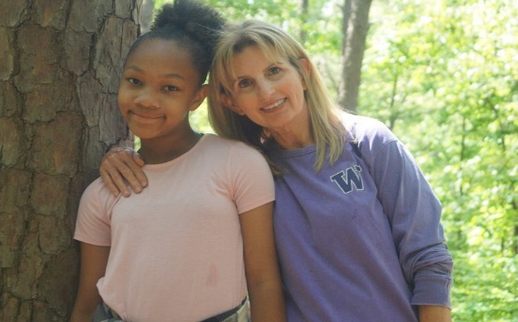
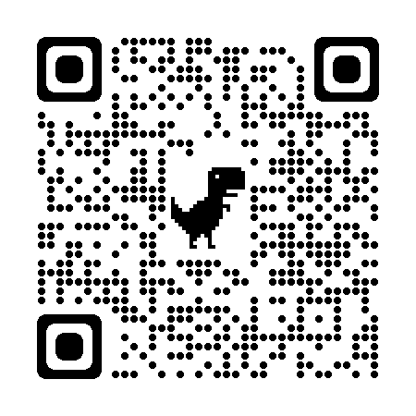
Do you have a passion to see children learn to read?
JOIN US!
SUMMER LITERACY CAMP
1 WEEK, 5 MORNINGS IN AUG!
GUIDED ONE-ON-ONE LITERACY TUTORING AND FUN!
SIGN UP NOW!
GO TO STEPMINISTRIES.ORG,
TEXT “SUMMER” TO 501.322.7242,
OR CLICK QR CODE:

